Slide 1
CDFA HEALTHY SOILS PROGRAM
2021 HSP Incentives Program
Bonus: Vermicompost
Demonstration Project Overview

Slide 2
Outline
Program Overview
Funding and Duration
Solicitation Timeline and Process
Review Process and Scoring Criteria
Eligibility and Exclusions
HSP Agricultural Management Practices
Project Duration and Requirements
How to Apply

Slide 3
PROGRAM OVERVIEW
Healthy Soils Program (HSP)
Stems from California Healthy Soils Initiative, a collaboration of state agencies and departments that promotes the development of healthy soils on California’s farmlands and ranchlands.
Competitive grant program: HSP Incentives Program and HSP Demonstration Projects
Objectives: To build soil organic carbon and reduce atmospheric greenhouse gases (GHGs).
HSP Incentives Program provides financial incentives to California growers and ranchers to implement agricultural management practices that sequester carbon, reduce atmospheric GHGs and improve soil health which also leads to efficient use of water.

Slide 4
FUNDING AND DURATION
Funding sources:
Budget Act of 2021 - $65 Million
Program Funding:
HSP Incentives Program:
Maximum Grant Amount: $100,000 per application
Grant (Project) Duration:
3 Years

Slide 5
SOLICITATION TIMELINE
Activity | Dates
Invitation to Submit Grant Applications | November
CDFA Grant Application Workshops and Webinars | https://www.cdfa.ca.gov/oefi/healthysoils/IncentivesProgram.html
Applications Due | February 25, 2022
Review Period | Rolling
Award Announcement | Rolling
Notes:
In this slide, please ensure to highlight that TAPs should conduct workshops and assistance in Jan-Feb.

Slide 6
SOLICITATION PROCESS
Unsuccessful applicants notified
Grant Applications Submitted to CDFA
Administrative review
Technical Review
Successful Applicants notified selected to receive an award
Pre-Project Consultations and Execution of Grant Agreements
Project begins

Slide 7
REVIEW PROCESS
Multiple Stages of Review:
Step1: Administrative Review: Internal – Conducted by CDFA
Step 2: Technical Review: External – Conducted by Technical Reviewers (University experts)
The total score of an application must be 40 points or above to be considered qualified for funding
Applications Prioritized for Funding: Projects serving Severely Disadvantaged Communities (SDACs), Socially Disadvantaged Farmers or Ranchers, and/or Priority Populations
Additional Considerations: cost share during grant duration, NRCS Conservation Plan

Slide 8
SCORING CRITERIA
Criteria | Score
Project Logistics | 10
Project Design | 10
Project Work Plan | 10
Project Budget and GHG Emission Estimate | 20
Conservation Plan (if applicable) | 10
Total | 60

Slide 9
PROGRAM ELIGIBILITY
California farmers, ranchers and Federal and California Recognized Native American Indian Tribes.
Projects must be located on California agricultural operations, reduce agricultural GHGs and sequester soil carbon.
Applicant must have control of the land for the duration of the grant:
Letter of agreement from landowner for leased land is required
One application per unique tax identification number.
Grant amount cannot exceed $100,000.
Implement at least one HSP Agricultural Management Practice on land where it was not implemented previously within the past year.

Slide 10
PROGRAM EXCLUSIONS
Grant funds cannot be used to implement practices other than those listed in the HSP solicitation.
Grant funds cannot be used to fund fields or Assessor Parcel Numbers (APNs) with existing and ongoing implementation of any HSP agricultural management practices.
Grant funds cannot be used to fund fields on which a HSP Demonstration or Incentives project was previously awarded.

Slide 11
HSP Management Practices Orchard/Vineyard
Compost Application
Compost purchased from certified facility
Compost produced on farm
Conservation Cover (USDA NRCS CPS 327)
Cover Crop (USDA NRCS CPS 340)
Filter Strip (USDA NRCS CPS 393)
Hedgerow Planting (USDA NRCS CPS 422)
Mulching (USDA NRCS CPS 484)
Natural materials
Wood chips
Nutrient Management (USDA NRCS CPS 590) (15% reduction in fertilizer application only)
Residue and Tillage Management – No Till (USDA NRCS CPS 329)
Residue and Tillage Management – Reduced Till (USDA NRCS CPS 345)
Whole Orchard Recycling
Windbreak/Shelterbelt Establishment (USDA NRCS CPS 380)

Slide 12
HSP Management Practices Cropland
Alley cropping (NRCS CPS 311)
Compost application (CDFA)
Conservation cover (NRCS CPS 327)
Conservation crop rotation (NRCS CPS 328)
Contour buffer strips (NRCS CPS 332)
Cover crop (NRCS CPS 340)
Field border (NRCS CPS 386)
Filter strip (NRCS CPS 393)
Forage and biomass planting (NRCS CPS 512)
Grassed waterway (NRCS CPS 412)
Hedgerow planting (NRCS CPS 422
Herbaceous wind barrier (NRCS CPS 603
Mulching (NRCS CPS 484)
Multistory cropping (NRCS CPS 379)
Nutrient management (NRCS CPS 590
Residue tillage management (NRCS CPS 329)
Riparian forest buffer (NRCS CPS 391)
Riparian herbaceous cover (NRCS CPS 390)
Strip cropping (NRCS CPS 585)
Tree/Shrub establishment (NRCS CPS 612
Vegetative barriers (NRCS CPS 601)
Windbreak/Shelterbelt establishment (NRCS CPS 380)

Slide 13
HSP Management Practices Grazing Land
Compost application to grassland (CDFA)
Hedgerow planting (NRCS CPS 422)
Prescribed grazing (NRCS CPS 528)
Range planting (NRCS CPS 550)
Riparian forest buffer (NRCS CPS 391)
Silvopasture (NRCS CPS 381)
Tree/shrub establishment (NRCS CPS 612)
Windbreak/Shelterbelt establishment (NRCS CPS 380)

Slide 14
NON-OVERLAPPING PRACTICES
Practices in the same group cannot be implemented on the exact same land area or field, i.e., cannot overlap.
Group I
Cover Crop (USDA NRCS CPS 340)
Conservation Crop Rotation (USDA NRCS CPS 328)
Strip Cropping (USDA NRCS CPS 585)
Group II:
Residue and Tillage Management – No-Till (USDA NRCS CPS 329)
Residue and Tillage Management − Reduced Till (USDA NRCS CPS 345)
Group III:
Compost Application: Compost is either
Purchased from a Certified Facility
On-farm Produced Compost
Group IV:
Alley Cropping (USDA NRCS CPS 311)
Multi-story Cropping (USDA NRCS CPS 379)

Slide 15
PROJECT DURATION
Project Year | Duration of Project Year | Practice Implementation Must Begin No Later Than
1 | Date of grant agreement – June 30, 2023 | Dec 31, 2022
2 | July1, 2023 – June 30, 2024 | Dec 31, 2023
3 | July 1, 2024 – March 31, 2024 | Dec 31, 2024

Slide 16
PROGRAM REQUIREMENTS (1)
Baseline data for each APN/Field:
Cropping history in the past three years (2019-2021)
Management history in the past three years (2019-2021)
Proposed plan of crops for next three years (2022-2025)
Must provide GHG Emissions Reduction Benefit Report using
CDFA HSP COMET-Planner

Slide 17
PROGRAM REQUIREMENTS (2)
Requirements on Practice Implementation and Verification
Selected projects are subjected to pre-project consultation before the grant contract is signed.
Implementation of practice(s) must be located on the same field/APN(s) during the entire project duration.
Implementation of practices must begin prior to December 31 in each project year.
Reports on soil organic matter content prior to practice implementation, and one, two and three years after practice implementation to be submitted to CDFA.
Awarded projects are subjected to verification to evaluate the project site and implementation of eligible agricultural management practice(s).

Slide 18
ONLINE APPLICATION PROCESS
Web-based application portal
Replan tool
Important documents to review before start to apply:
HSP Incentives Program Request for Grant Applications (RGA)
Frequently Asked Questions
Important documents to download for preparing submission:
Project Work Plan Template

Slide 19
APPLICATION CONTENTS
Applicant Information
Project Overview
Project Logistics
Project Design
Project Work Plan
Project Budget
Funding requested
Optional cost share
GHG Reduction Estimation
Conservation Plan (Optional)
Benefits to (Optional, Prioritized)
Severely Disadvantaged Communities (Community FactFinder)
Socially Disadvantaged Groups, and/or
Priority Populations (CalEnviroScreen 3.0)

Slide 20
PROJECT OVERVIEW
Project Title:
Project Description (project abstract)
Project Budget
Funds requested
Cost share (optional)
Total Project Budget (funds requested + cost share)

Slide 21
PROJECT LOGISTICS
Project Site Information:
APN, address, Latitude/Longitude, Leased Land?
Letter of Landowner Agreement for leased land if applicable
Project Logistics
Practice name, APN# /Field name, Acres, Implemented previously?
Baseline Data
Cropping history
Management history
Compost Application Eligibility
Compost Application is not eligible on APNs where soil organic matter content is greater than 20% by dry weight at top 20 cm depth (8 inches)

Slide 22
PROJECT DESIGN
Project Design Must Include:
A Map including a landmark and specific Fields/APNs. (REPLAN)
A layout of where all eligible management practices to be implemented. (REPLAN)
The total acreage for each practice to be implemented. (REPLAN)
Indicate compost C:N ratio, application rate, plant species to be planted on each field, if applicable.

Slide 23
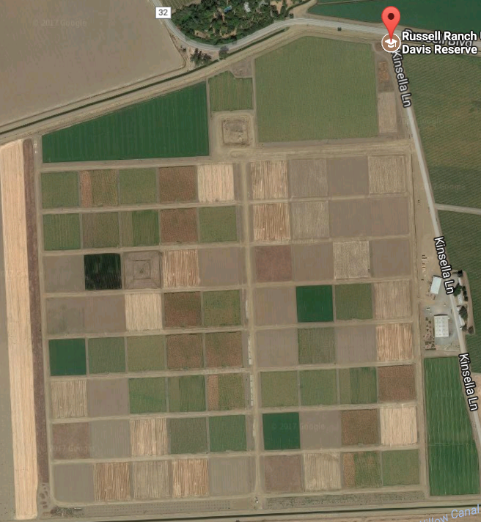
AN EXAMPLE OF PROJECT DESIGN
Requirements for a Project Design
REPLAN Tool
Required Information for a Project Design
Field 1
APN: 123-555-507-000
1. Compost Application:
Field 1: Annual cropland – 30 acres
C:N≤11 at 3 tons/Ac
Field 3: Perennial cropland – 40 acres
C:N > 11 at 6 tons/Ac
2. Windbreak Establishment: Field 1 & 2 – 1000 feet
(marked by ) Plant: Eastern Redcedar
3. Cover Crop: Field A – 25 acres
Triticale, 100 lbs/acre
Compost Application
Field 2
Windbreak Row
APN: 123-555-507-000
Field A: cover crop
APN: 123-475-090-000
Compost Application

Slide 24
CONSERVATION PLAN (OPTIONAL)
The Conservation Plan must be submitted as a PDF and include, at a minimum, all of the following:
An aerial photo or diagram of project fields.
A list of current management decisions.
The location of and schedule for applying new conservation practices.
Resource Assessment which includes an inventory of resources and resource concerns, soils information, topographic maps, plan maps showing location of property, existing practices, structures, planned practices, soils, water features and other environmentally sensitive areas, and environmental assessment.
Information explaining how specific management decisions will be implemented.
A plan for operation and maintenance of selected management practices.

Slide 25
GROUNDS FOR DISQUALIFICATION
Incomplete grant applications:
Applications with one or more unanswered questions necessary for administrative or technical review.
Applications with missing, blank, unreadable, corrupt, or otherwise unusable attachments.
Applications requested for more than the maximum award amount.

Slide 26
PAYMENT PROCESS
Flat rate payment system based on practice implementation
Reimbursement
Annual Invoicing
Compost repayments are based on maximum allowable application rate
Recipients can apply for up to 25% advance payment
Notes:
We have a sample to show you the breakdown of costs and the basic information that we need on the invoice – agreement number, which CSA program, etc.

Slide 27
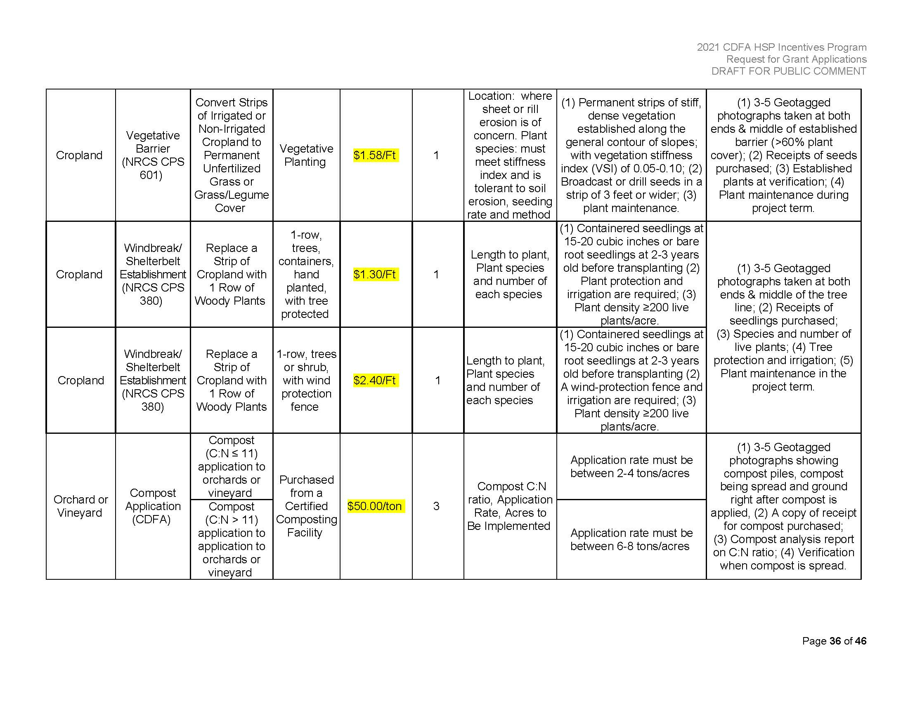

Slide 28
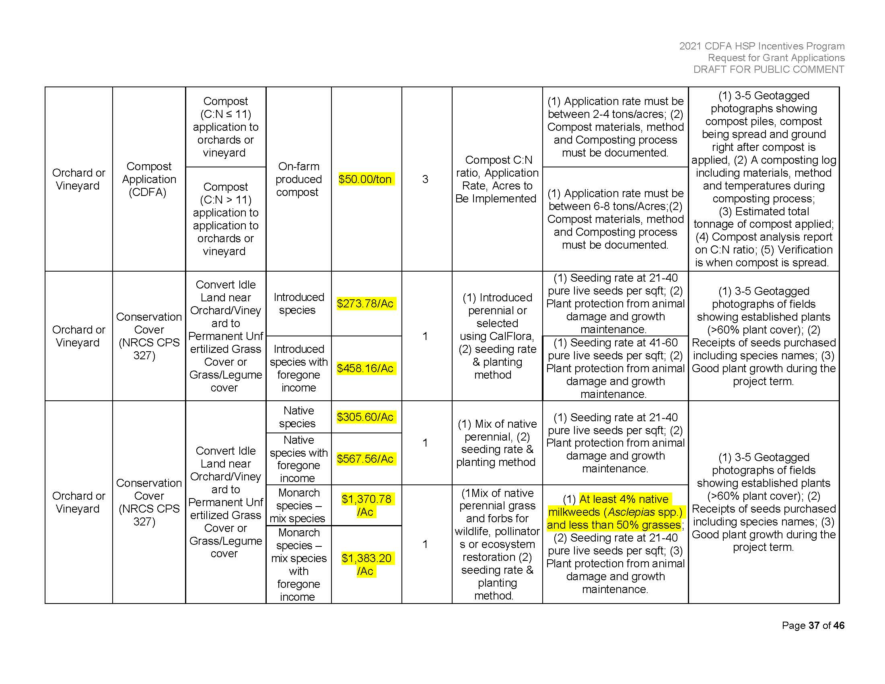

Slide 29
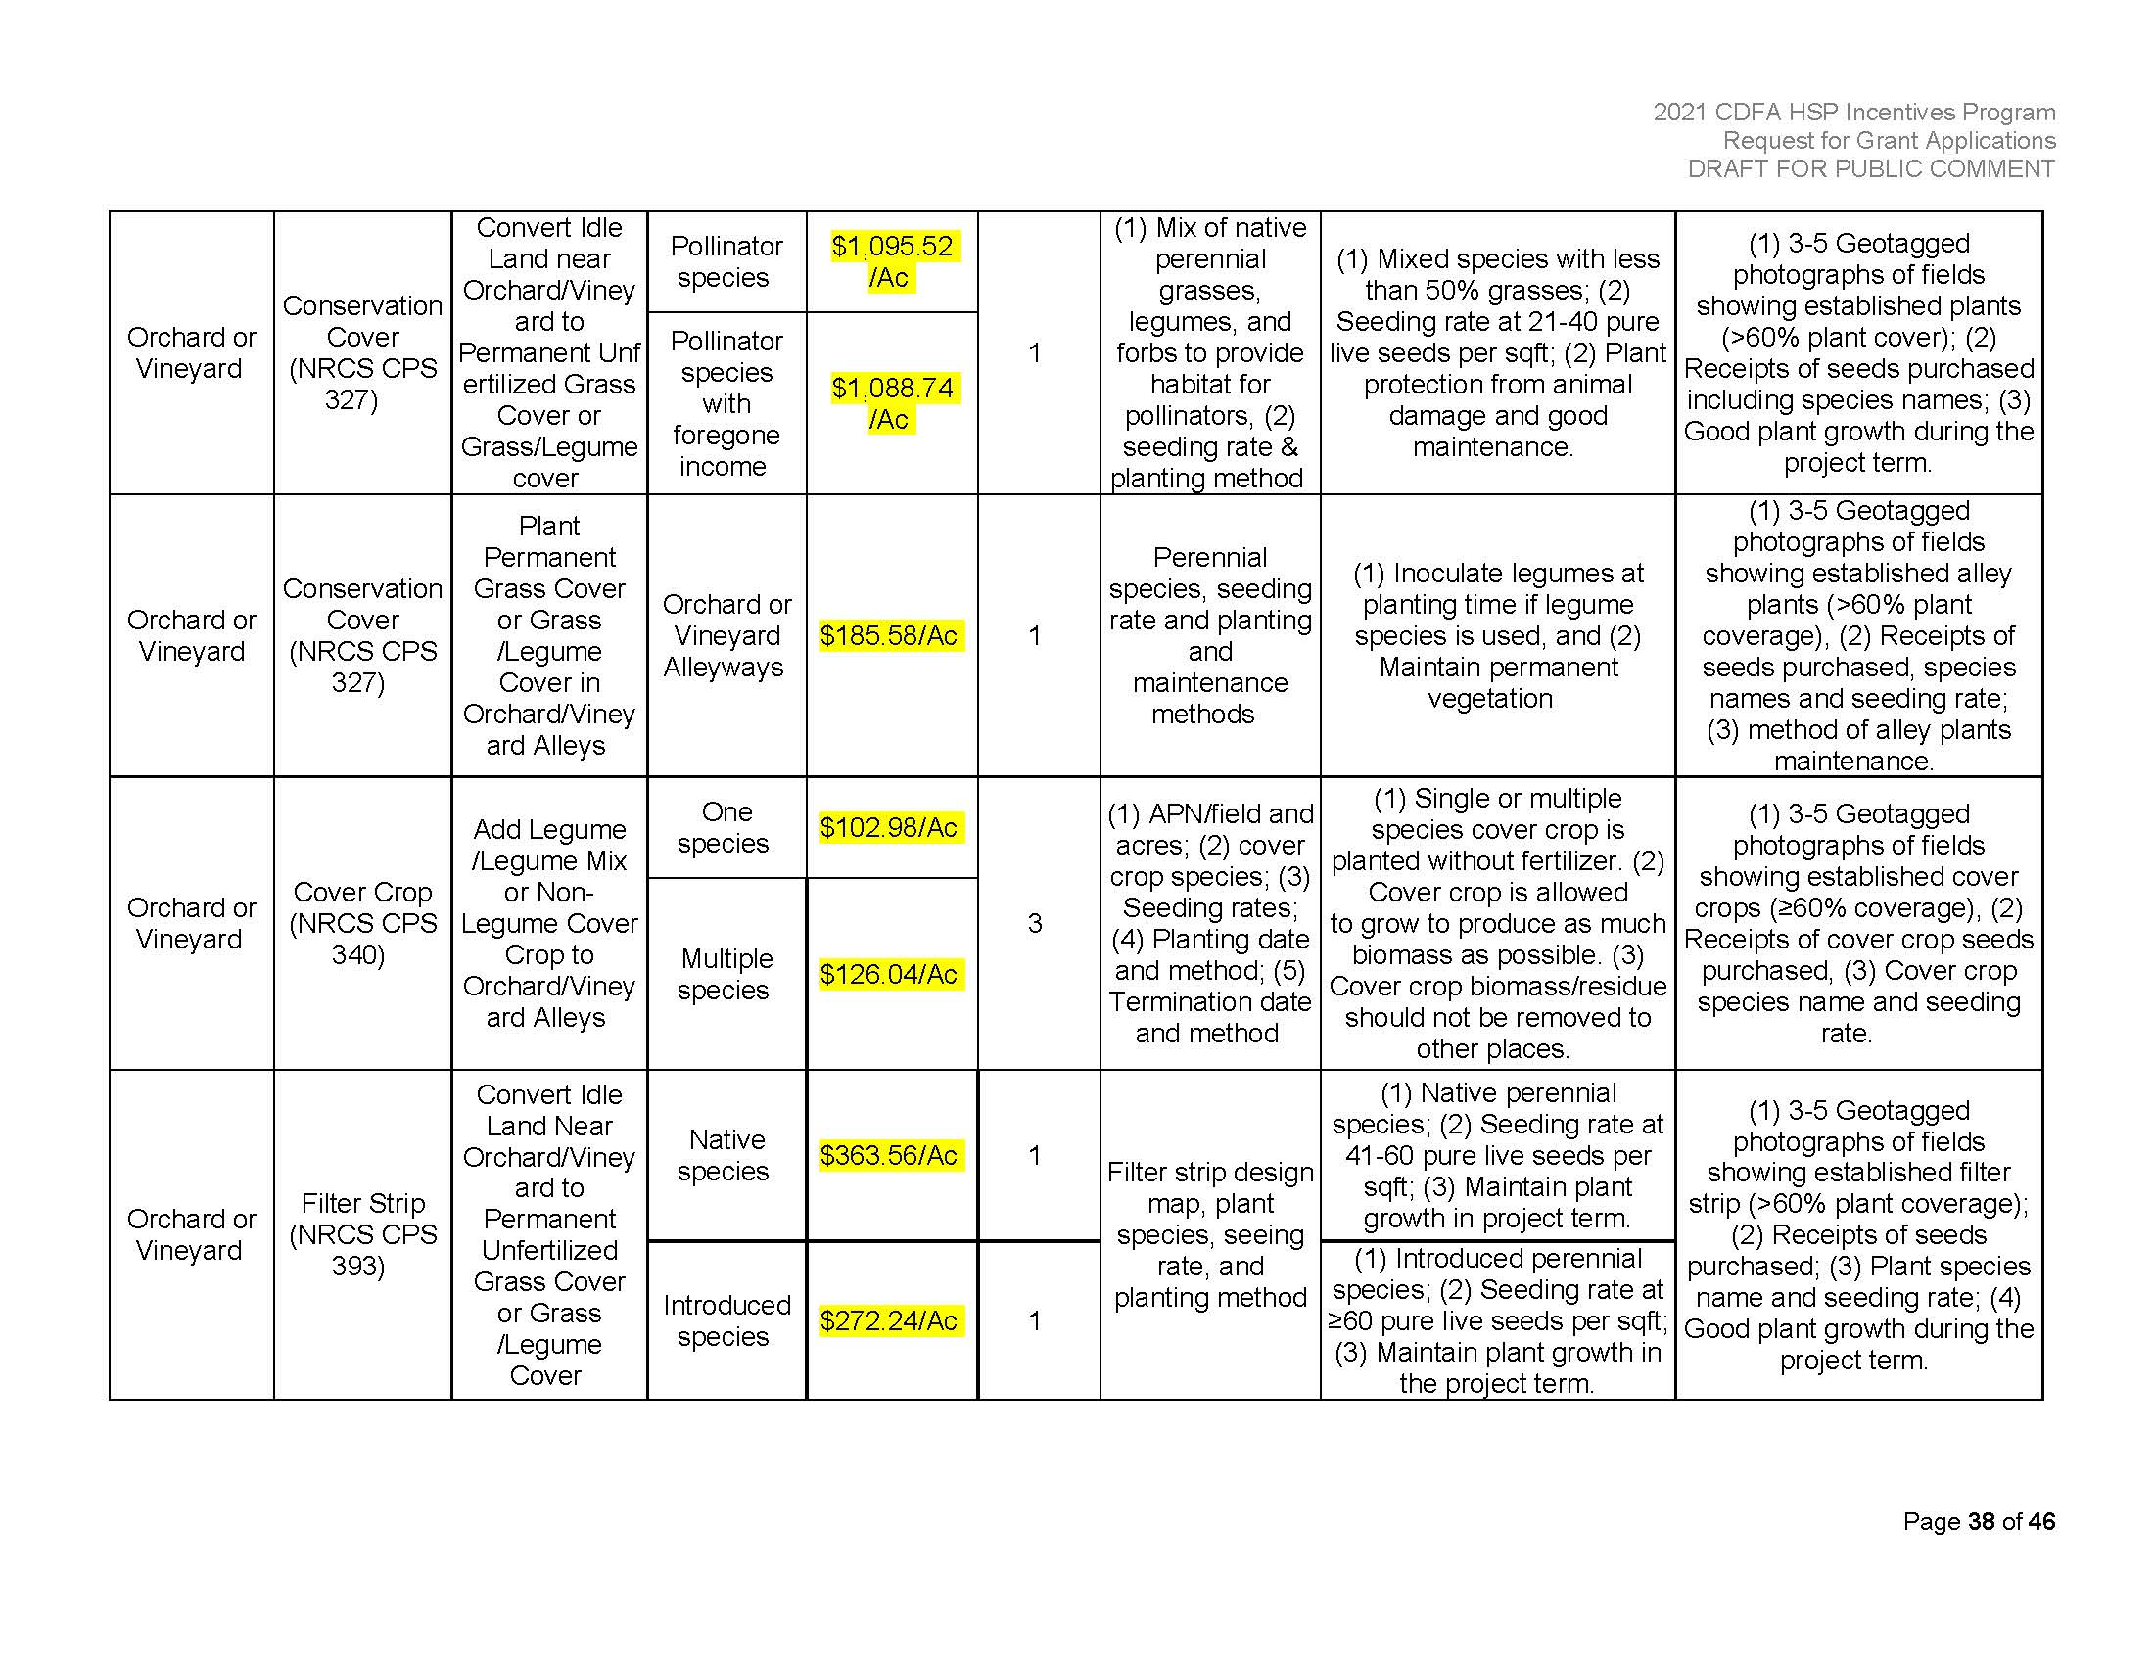

Slide 30
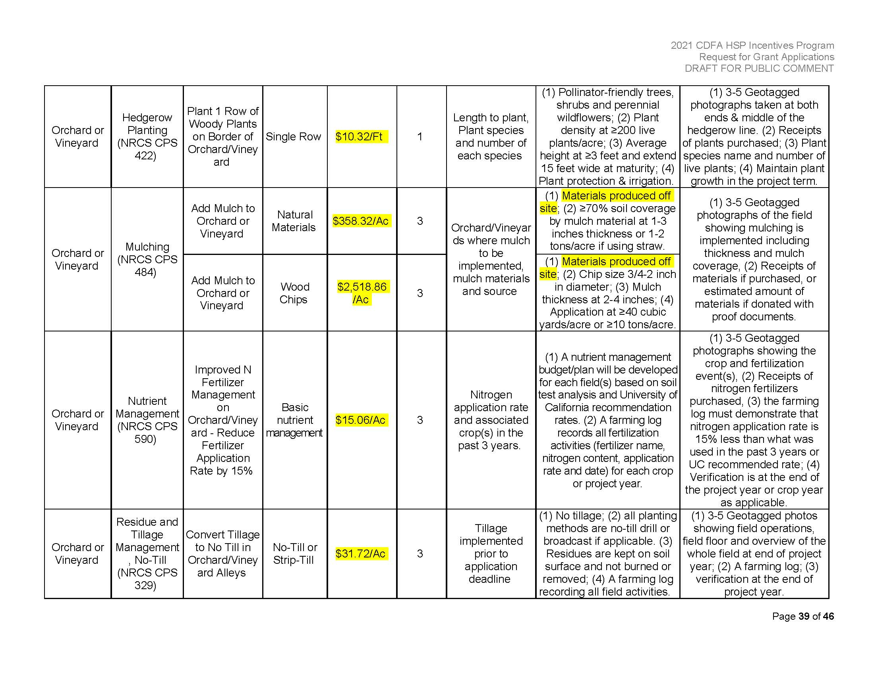

Slide 32
HSP Demonstration Projects
Type A
GHG data collection
Different list of practices
Must include control plot
Annual SOM data
Crop yield data
1 annual workshop
Maximum of $250,000
Type B
Same practice list as Incentive Program
Annual SOM data
1 annual workshop
Maximum of $100,000

Slide 33
HSP Demonstration Project
Anaerobic digestate application
Microbial inoculation with compost tea
Mycorrhizal application
Nutrient management (replacing N fertilizer with alternative amendments)
Vermicompost application
Biochar application
Food waste hydrolysate application

Slide 34
2019 Vermicompost Trial
USLTRCD, Black Diamond Vermicompost, Cal Poly, Castoro Cellars, Mesa Vineyard Management
Replicated Plots: Vermicompost, LCE, Organic Dairy Compost, Control
GHG collection, SOM, PLFA, Crop Yield
2022 Workshop at BD Facility or project site.

Slide 35
Project Design

Slide 36
CONTACTS
Andrew@us-ltrcd.org
805-536-3175
www.US-LTRCD.org

